Slide 1


I Project Presentation (KCS 753) (Integrated Information Platform for Indian University)
KIET Group of Institutions, Ghaziabad
(An ISO – 9001: 2008 Certified & ‘A+’ Grade accredited Institution by NAAC)
Guide Name: Prof. Shivani
Project Members Name with Roll Number & Section
1. Prabhat Sahrawat-2100290120120(cs7B)
2.Ashwin Yadav-2100290120057(cs7B)
3.Harsh-21002901200083(cs7B)
4. Mayank Choudhary-2100290120104(cs7B)

Slide 2
Integrated Information Platform for Indian University
B.tech(C.S)

Slide 3
Table of contents
01
03
02
04
Introduction
Administrations
Objectives
Resources

Slide 4
Introduction
Our platform is designed to help students. Here’s a simpler explanation:
“Our website helps students find the right colleges by providing information about placement rates and other important factors. You can explore colleges, compare them, and make informed decisions, it will also help in finding the right course for skill enhancement.”
.

Slide 5
The two pillars of Our WebApp
With our user-friendly interface and extensive database, we aim to streamline the college selection process and enhance the educational experience for students across the globe.

Slide 6
The current landscape presents a significant challenge for students navigating the higher education journey, as they are compelled to scour multiple disparate platforms for comprehensive college information. This fragmented approach not only consumes valuable time but also hampers informed decision-making. Moreover, the decentralized availability of online courses across numerous platforms adds another layer of complexity, hindering students' access to diverse learning opportunities conveniently. The lack of a centralized platform integrating college information and online courses exacerbates this issue, highlighting the pressing need for a unified solution to streamline the search process and enhance accessibility to educational resources.
Problem Statement

Slide 7
Objective
02
Our WebApp Poses some Objectives here are some :-

Slide 8
Centralized College Information
Mentor Guidance Integration
Provide a unified platform offering detailed, verified data on Indian universities, including courses, faculty, rankings, and infrastructure. This reduces dependency on scattered sources and helps students make informed decisions. The platform simplifies the college selection process through accessible and transparent information, saving time and improving decision-making for students and their families.
Connect students with experienced mentors for personalized, one-on-one career guidance. The system allows real-time booking and mentor filtering based on specialization and availability. This bridges the guidance gap in Indian education, enabling students to align academic decisions with career goals while offering mentors a structured way to contribute and earn.

Slide 9
User-Friendly Interface
Secure and Scalable System
Develop a responsive, intuitive interface using React.js for seamless user interaction. Features like real-time updates, advanced search, and filters enhance usability. The platform ensures even first-time users can navigate effortlessly, improving engagement and helping students efficiently find suitable colleges and mentors with minimal effort and confusion.
Implement features that allow for personalized recommendations and tailored experiences based on user preferences, academic background, and career aspirations. By leveraging data analytics and, the website can deliver targeted content and suggestions, enhancing user engagement and satisfaction.

Slide 10
Project Abstract
Overview
Key Objectives
Approach
Highlighting the pressing need for a unified solution to streamline the search process and enhance accessibility to educational resources.
Ensure that all relevant information about colleges and universities is easily accessible to users, enabling them to make informed decisions about their academic future. This includes details such as admission requirements, program offerings, faculty profiles, campus facilities, and placement statistics.
This fragmented approach not only consumes valuable time but also hampers informed decision-making. Moreover, the decentralized availability of online courses across numerous platforms adds another layer of complexity, hindering students' access to diverse learning opportunities conveniently.

Slide 11

Alignment with UN Sustainable Development Goals (SDGs)
SDG 4: Quality Education
SDG 9: Industry, Innovation,
and Infrastructure
provides equal access to quality educational resources
reflects innovation in education infrastructure, making scalable
SDG 10: Reduced
Inequalities
SDG 17: Partnerships for the Goals
helps reduce inequality in access to academic resources, career support,
and learning opportunities.
Fostering collaboration between educational institutions, industry partners, and research bodies

Slide 12





Methodology and Approach
Login
Login involves the use of various authentication methods to verify the identity of users.
User Registration
The registration process starts with users filling out a form, providing necessary details like username, email, and password.
User Dashboard
The user dashboard is personalized, displaying information based on account settings, activity history, and preferences.
Search University
This feature includes a search bar for users to input keywords like university names, locations, degree programs, or specific criteria.

Slide 13




Expected Outcomes and Impact
Enhanced Access to Information
Reduced Digital Divide and
Greater Inclusion
Preparedness for Future
Education Models
Students, faculty, and administrators would have a single, centralized platform for accessing academic schedules, events, notifications, curriculum resources, and examination details.
Helps provide equal access to information and educational resources across urban and rural institutions.
Lays a foundation for adaptive and flexible learning models, such as hybrid and remote education.

Slide 14
Project Work Distribution
Prabhat Sehrawat
Ashwin Yadav
Mern Stack, Project Lead
React js, Frontend Lead
Harsh
Mayank Choudhary
Frontend
Frontend

Slide 15
Characteristics of our WebApp
College Information
Admin Dashboard
Mentor Availability
User Dashboard

Slide 16
Technology Used
React js
Express js
Dockerize
Final
Frontend
Backend
Deployment
Scalability

Slide 17
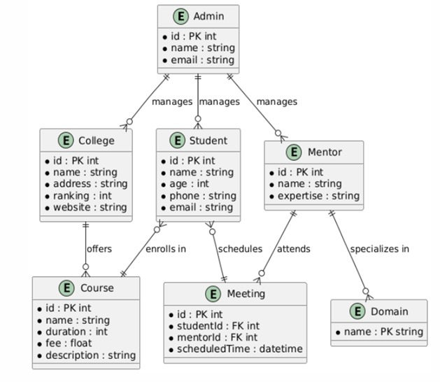
ER Diagram

Slide 18
Patent Status
Soft copy proof of submission/ publication.

Slide 19
Thanks!
Do you have any questions?
theprabhatsehrawat@gmail.com
+91 9084539879
collegeSearch.com

